Slide 1
In vivo localisation of Luteinising hormone-FITC peptides 4/3/20
58 day old male mice were injected with a 300 µl dose of 1 mM peptide-FITC (in 30% Kolliphor-PBS) or vehicle
Treatments:
1. vehicle (30% Kolliphor-PBS)
2. GONBC35-FITC (non-specific peptide)
3. LHa-FITC (FITC-Ahx--MPA(GABA)SSSDAGGPRTQP-NH₂)
4. L95-FITC (FITC-Ahx-CSFPVALSSRSGPSRR-NH₂)
Eight hours post-injection, mice were euthanased using CO₂ asphyxiation
Cardiac blood was collected and the mice weighed before organs were collected, weighed, and imaged using the fluorescent dissection microscope. Tissues collected: seminal vesicles, testes, epididymides, adrenal glands, kidneys, liver, spleen, brain, heart, lungs, and pituitary.
Key to images
Vehicle- 30% Kolliphor
LHa-FITC
L95-FITC
GONBC35-FITC

Slide 2
Adrenal gland
Brain
Pituitary
Heart
Bright field
FITC
Bright field
FITC
Bright field
FITC
Bright field
FITC
Vehicle
LHa-FITC
1
L95-FITC
G35-FITC
Replicate
2
3
Lung
Kidney
Liver
Spleen
1
Replicate
2
3

Slide 3
Epididymis
Bright field
FITC
Vehicle
LHa-FITC
1
L95-FITC
G35-FITC
Replicate
2
3
Seminal vesicle
Replicate
2

Slide 4
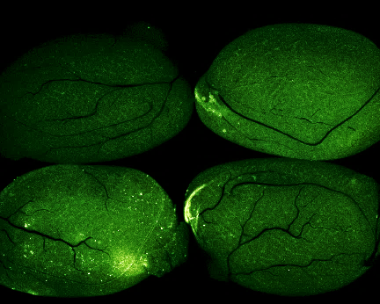
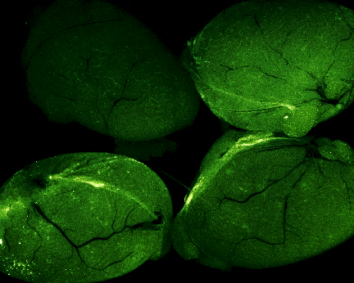
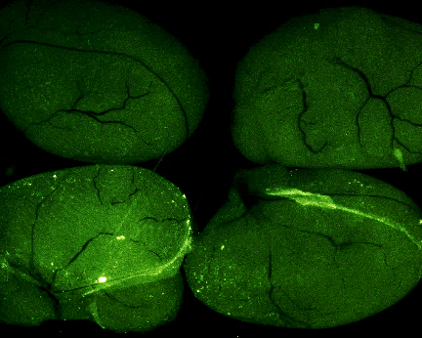
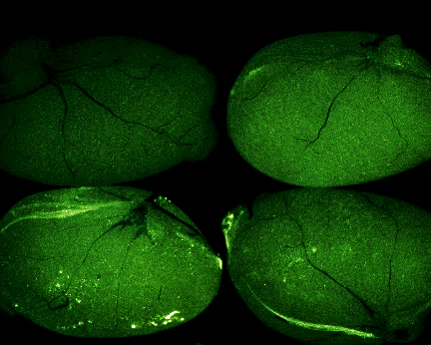
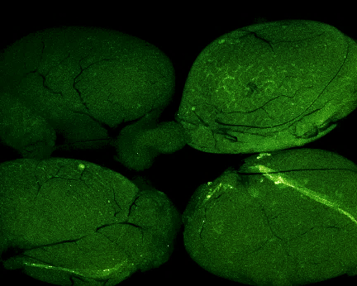
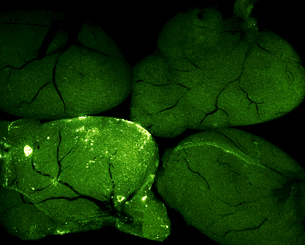
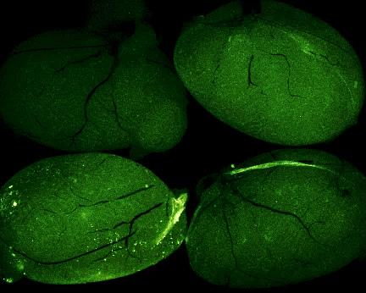
Replicate
1
2
3
Bright field
FITC
Bright field
FITC
Bright field
FITC
Vehicle- 30% Kolliphor
LHa-FITC
A1
L95-FITC
GONBC35-FITC
Testis/image
B1
A2

